Slide 1
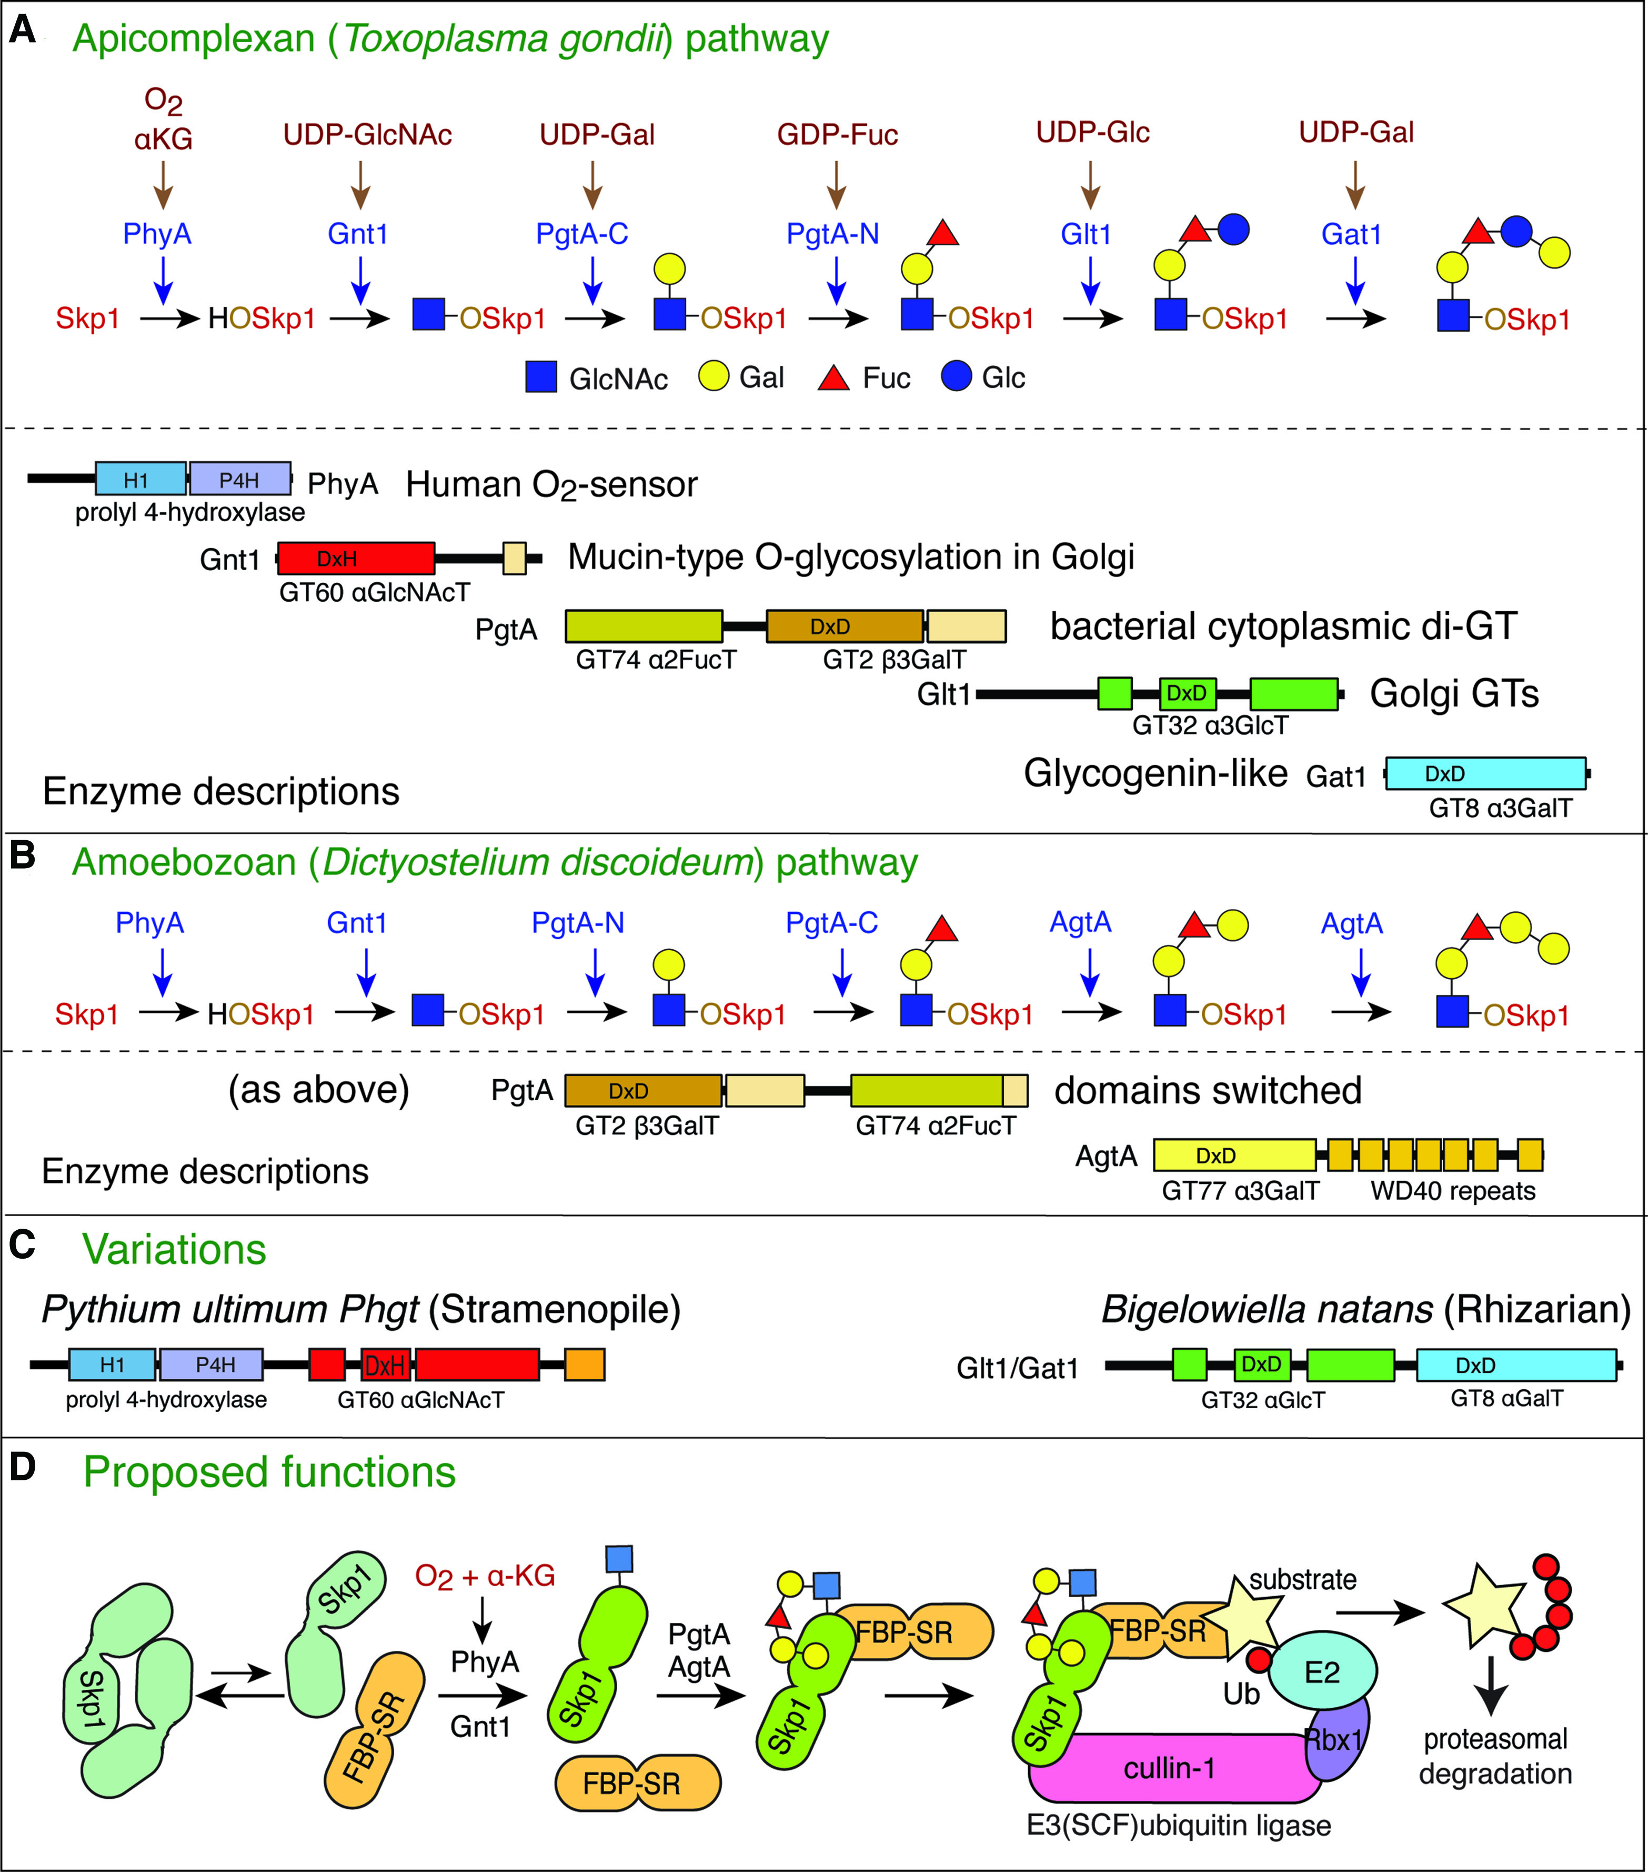
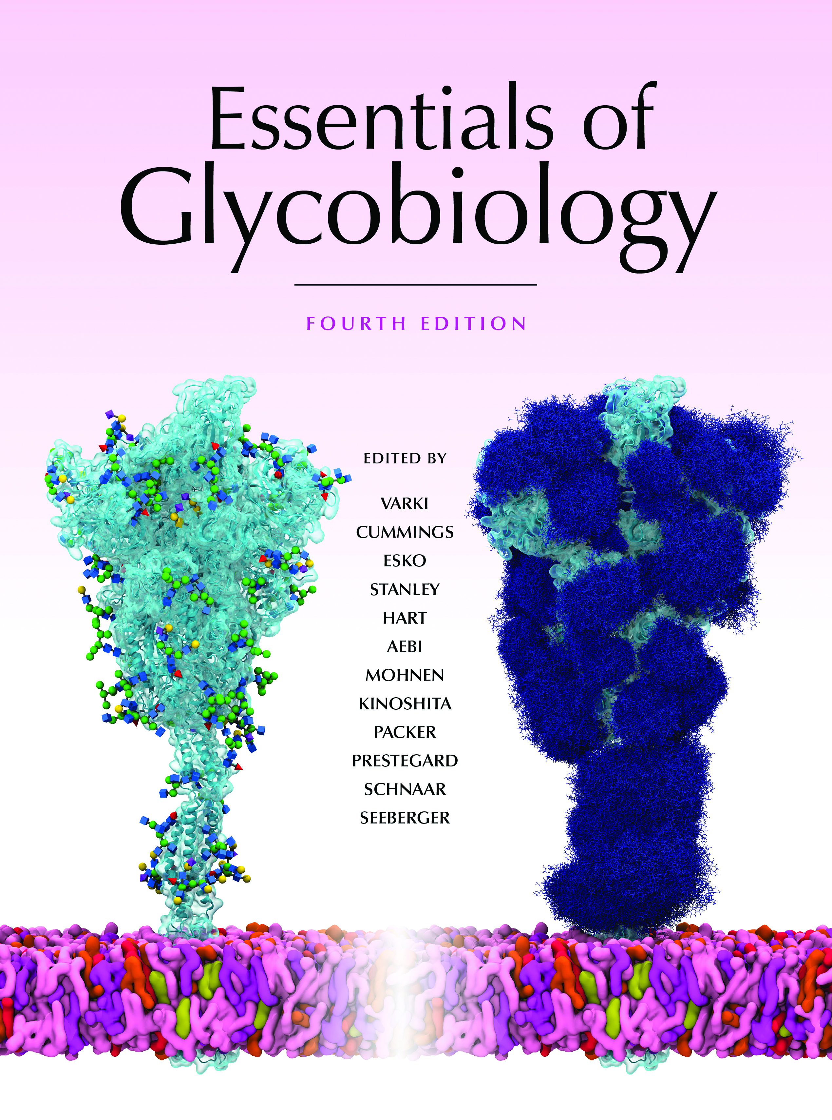
Mechanism of Glycosylation of Skp1 in the Cytoplasm of Protists
Chapter 18, Figure 2. Essentials of Glycobiology, Fourth Edition
Click here for Symbol Nomenclature for Glycans (SNFG) (Live only in slide display mode)
Buy the Book
©2022 The Consortium of Glycobiology Editors, La Jolla, California
Notes:
(Note: Embedded links are present but live only in the slide display mode.)
FIGURE 18.2. Mechanism of glycosylation of Skp1 in the cytoplasm of protists. Glycosylation is enabled by prior hydroxylation of a single Pro-residue by the action of a cytoplasmic, O2-dependent prolyl 4(trans)-hydroxylase that is homologous to the HIFα prolyl hydroxylases of animals that regulate transcriptional responses to hypoxia. (A) In the parasite Toxoplasma gondii, Skp1 hydroxyproline-154 is sequentially modified by a series of five soluble, sugar nucleotide–dependent glycosyltransferase activities expressed by four proteins. Below, domain diagrams of these enzymes, and the CAZy family designations of the glycosyltransferases, are illustrated. Notably, they are all cytoplasmic proteins lacking rough endoplasmic reticulum (rER) or nuclear targeting sequences. (B) In another protist, Dictyostelium, the equivalent Pro-residue is similarly modified, but the addition of the final two sugars is mediated by a different, dual function glycosyltransferase, suggesting convergent evolution to generate a similar glycan. (C) Schematic diagrams of enzyme homologs from other protists, depicting their expression as fusion proteins. Related glycosyltransferase genes are found in select representatives of all of the major branches of protist evolution and some pathogenic fungi, but not “higher” plants or animals. (D) Model for the role of hydroxylation and αGlcNAcylation in inhibiting Skp1 dimerization and affecting its conformation, the role of glycan extension on promoting interactions with F-box proteins, and predicted effects on the turnover of polyubiquitin ligase substrates.

