Slide 1
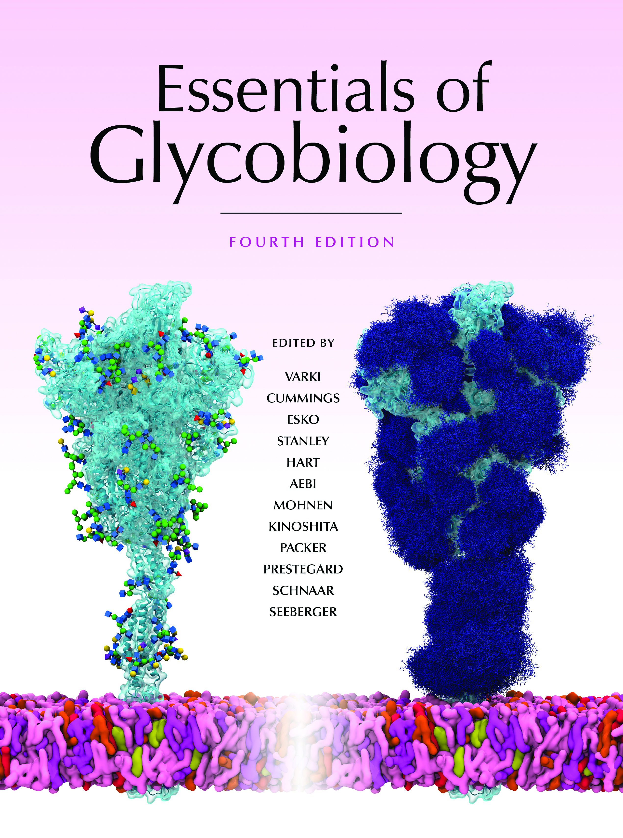
Loss of Normal Topology and Polarization of Epithelial Cells in Cancer Results in Secretion of Mucins with Truncated O-GalNAc Glycans
Chapter 47, Figure 2. Essentials of Glycobiology, Fourth Edition
Click here for Symbol Nomenclature for Glycans (SNFG) (Live only in slide display mode)
Buy the Book
©2022 The Consortium of Glycobiology Editors, La Jolla, California
Notes:
(Note: Embedded links are present but live only in the slide display mode.)
FIGURE 47.2. Loss of normal topology and polarization of epithelial cells in cancer results in secretion of mucins with truncated O-GalNAc glycans, such as sialyl-Tn (STn) and Tn, into the bloodstream. Tumor cells invading tissues and the bloodstream also present mucins on their cell surfaces.

