Slide 1
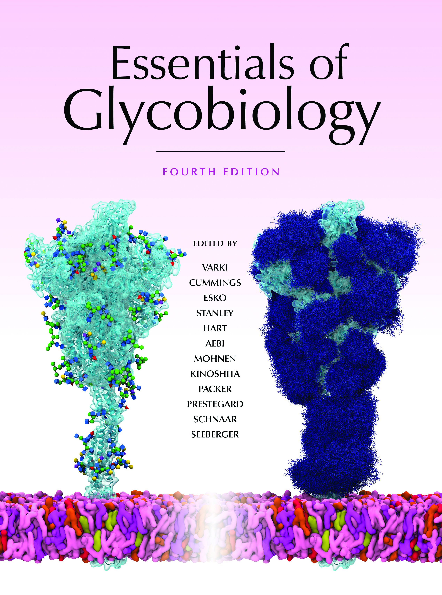
N-Glycans Increase in Size on Neoplastic Transformation of Cells
Chapter 47, Figure 1. Essentials of Glycobiology, Fourth Edition
Click here for Symbol Nomenclature for Glycans (SNFG) (Live only in slide display mode)
Buy the Book
©2022 The Consortium of Glycobiology Editors, La Jolla, California
Notes:
(Note: Embedded links are present but live only in the slide display mode.)
FIGURE 47.1. N-Glycans increase in size on neoplastic transformation of cells, in part because of increased MGAT4 and MGAT5 activity, which catalyzes GlcNAc branching of N-glycans. This may lead to increased numbers of LacNAc units, which can also be sialylated and fucosylated. The resulting glycans may be recognized by galectins and selectins. Increased FUT8, which transfers the core α1-6Fuc to N-glycans, also enhances tumor progression. In contrast, increased MGAT3, which catalyzes transfer of the bisecting GlcNAc to N-glycans, may suppress tumor progression, in part by inhibiting galectin binding.

