Slide 1
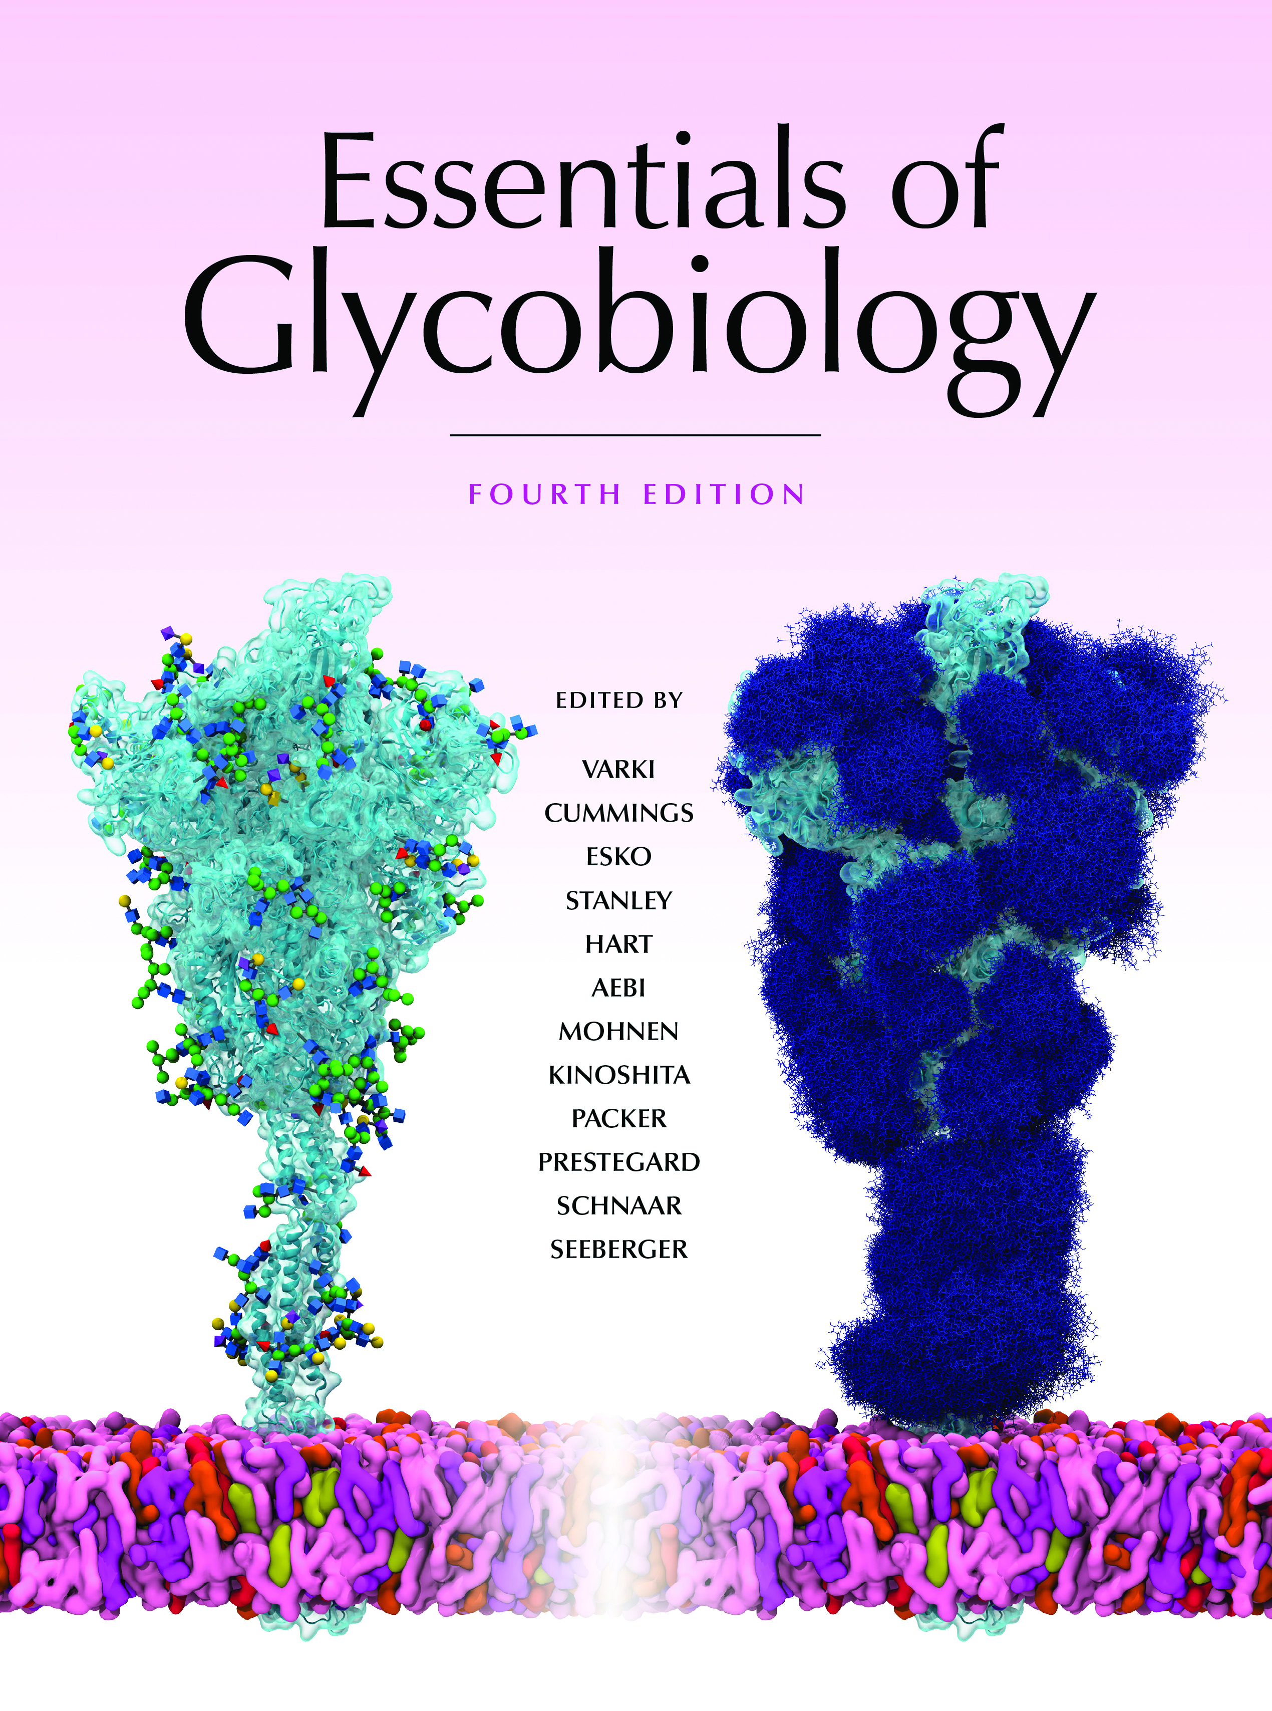
Notch Signaling Pathway
Chapter 13, Figure 3. Essentials of Glycobiology, Fourth Edition
Click here for Symbol Nomenclature for Glycans (SNFG) (Live only in slide display mode)
Buy the Book
©2022 The Consortium of Glycobiology Editors, La Jolla, California
Notes:
(Note: Embedded links are present but live only in the slide display mode.)
FIGURE 13.3. Notch signaling pathway. Notch exists on the cell surface as a heterodimer in which the extracellular domain is tethered to the transmembrane and intracellular domain by noncovalent, calcium-dependent interactions. Notch is activated by ligand (members of the Delta or Jagged families in mammals) expressed on the surface of a "sending cell." Both ligands are shown, but typically the sending cell would predominantly express one or the other. Binding of ligand induces a conformational change in the Notch receptor, exposing a protease site for a cell-surface protease (either ADAM10 or ADAM17). This extracellular cleavage is followed by a second cleavage, catalyzed by γ-secretase, which results in release of the Notch intracellular domain as a soluble protein in the cytoplasm of the "receiving cell." The Notch intracellular domain translocates to the nucleus where it interacts with members of the CSL (CBF1, Su(H), Lag-1) family of transcriptional regulators and activates transcription of a number of downstream genes. Notch expressed in receiving cells without Fringe (left) is compared with cells that express Fringe (right). The presence of Fringe results in elongation of O-fucose and alters the ability of Notch to respond to ligands on the sending cell. In this example, Fringe causes an increase in Delta signaling and a decrease in Jagged signaling. (Modified, with permission of the Annual Review of Biochemistry, from Haltiwanger RS, Lowe JB. 2004. Annu Rev Biochem 73: 491–537, © Annual Reviews.)

