Slide 1
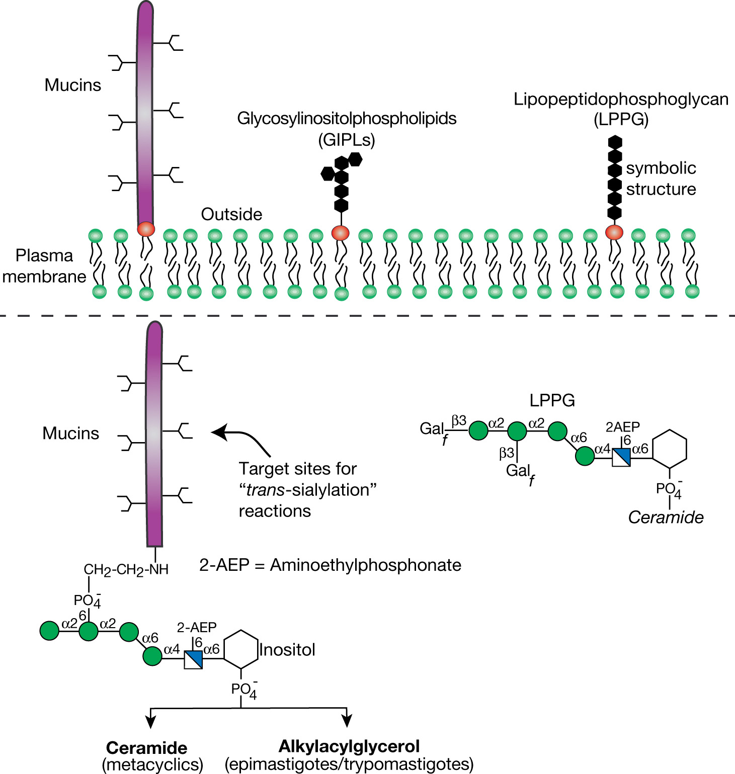
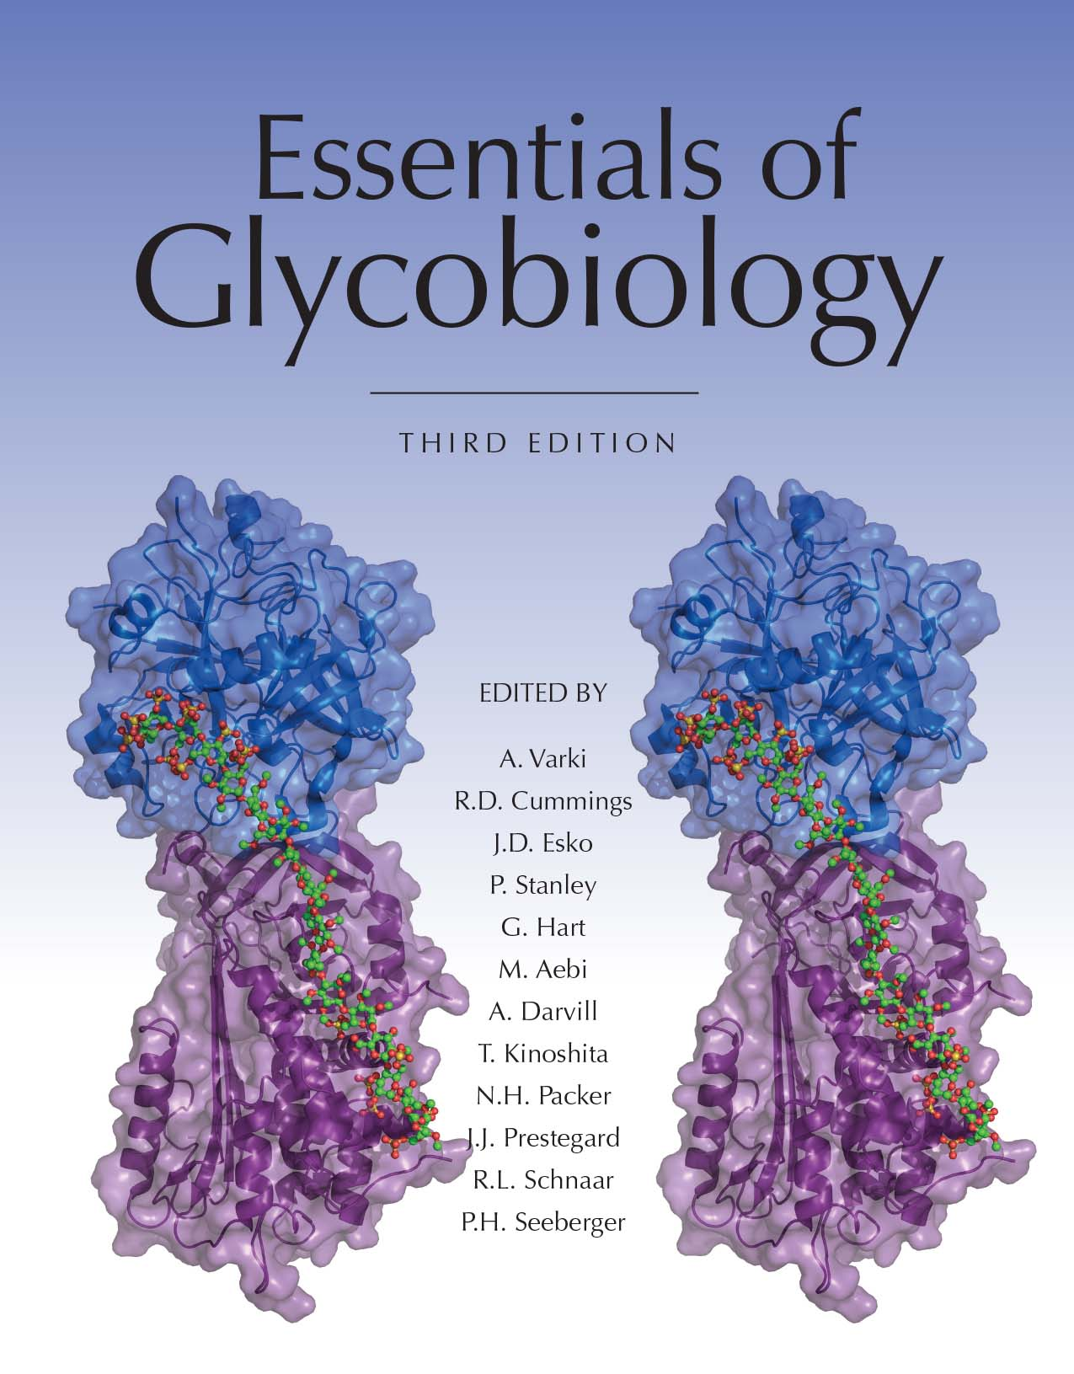
Schematic Representation of the Major Surface Glycoconjugates
of Trypanosoma cruzi
Chapter 43, Figure 3. Essentials of Glycobiology, Third Edition
Symbol Nomenclature for Glycans (SNFG)
Buy the Book
©2017 The Consortium of Glycobiology Editors, La Jolla, California
Notes:
FIGURE 43.3. Schematic representation of the major surface glycoconjugates of Trypanosoma cruzi. The cell surface of T. cruzi is covered with a dense layer of mucins, glycosylinositolphospholipids (GIPLs), and lipopeptidophosphoglycan (LPPG). The structures of the mucin anchors and the predominant LPPG species are outlined. Aminoethylphosphonate residues are indicated by 2-AEP. For the monosaccharide symbol code, see Figure 1.5, which is also reproduced on the inside front cover.
(Note: For a key to symbols used for monosaccharides, use the SNFG link. Embedded links are present but live only in the slide display mode.)

