Slide 1
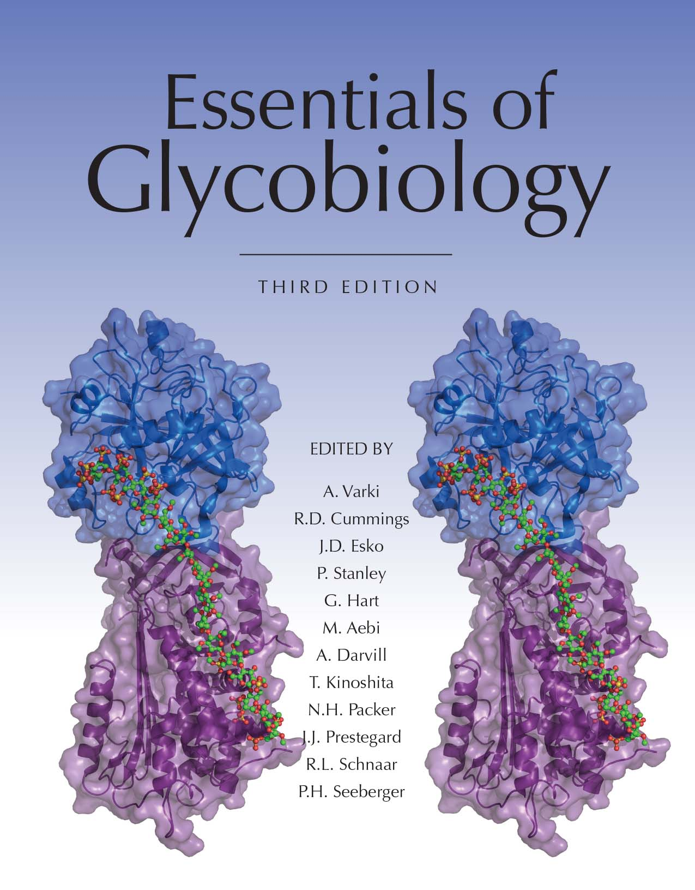
Examples of Symbols and Conventions for Drawing Glycan Structures
Chapter 1, Figure 5. Essentials of Glycobiology, Third Edition
Symbol Nomenclature for Glycans (SNFG)
Buy the Book
©2017 The Consortium of Glycobiology Editors, La Jolla, California
Notes:
FIGURE 1.5. Examples of symbols and conventions for drawing glycan structures. The monosaccharide symbol set from the Second Edition of Essentials of Glycobiology remains intact but has been extended to cover a wider range of monosaccharides found in nature. A full table of symbols is available in Online Appendix 1B at the NCBI Books website. A few examples of symbols and the use of this system to depict naturally occurring glycans are shown here. (Left) Branched “biantennary” N-glycan from a vertebrate, with two types of outer termini, depicted at different levels of structural details. (Right) Examples of glycosaminoglycan (GAG) chains from metazoan animals, a plant glycan, and a bacterial lipopolysaccharide.
(Note: For a key to symbols used for monosaccharides, use the SNFG link. Embedded links are present but live only in the slide display mode.)

