Slide 1
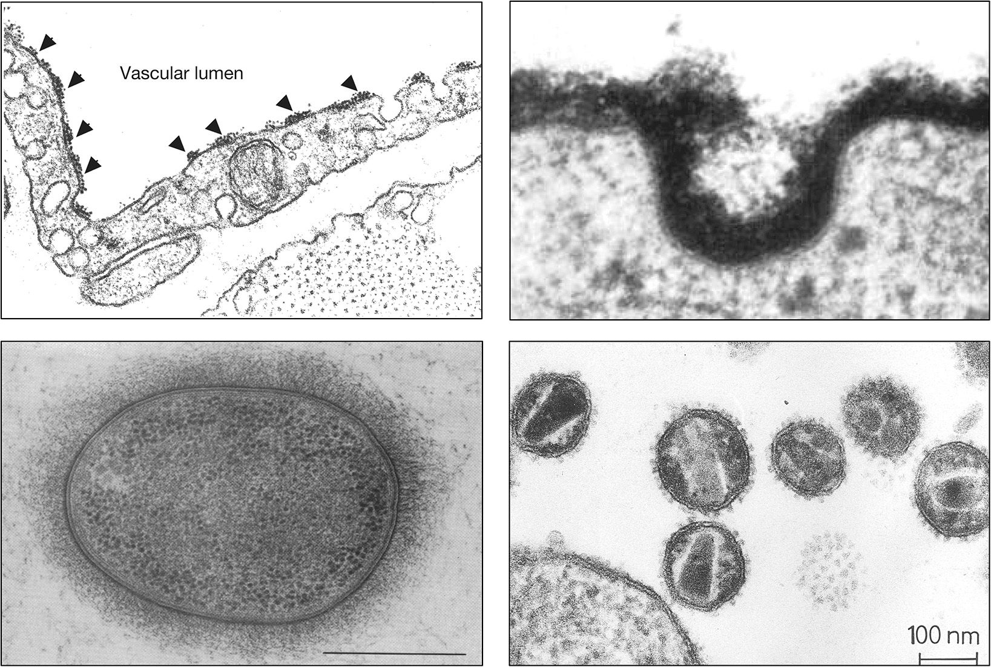
All Cells in Nature Are Coated with a Dense Array
of Glycans
Chapter 1, Figure 4. Essentials of Glycobiology, Third Edition
Buy the Book
©2017 The Consortium of Glycobiology Editors, La Jolla, California
Notes:
FIGURE 1.4. (Upper left) Historical electron micrograph of endothelial cells from a blood capillary in the rat diaphragm muscle, showing the lumenal cell membrane of the cells (facing the blood) decorated with particles of cationized ferritin (arrowheads). These particles are binding to acidic residues (sialic acid – containing glycans and sulfated glycosaminoglycans) contained in the cell-surface glycocalyx. Note that the particles are several layers deep, indicating the remarkable thickness of this layer of glycoconjugates. (Courtesy of the late George E. Palade, University of California, San Diego). (Upper right) Electron micrograph of fibroblast glycocalyx stained with ruthenium red (120,000×). (From Martinez-Palomo A, et al. 1969. Cancer Res 29: 925–937, with permission from American Association for Cancer Research.) (Lower left) Thin section of Klebsiella pneumonia showing capsular layers substitution fixed with osmium tetraoxide. Scale bar, 0.5 μm. (From Amako K, et al. 1988. J Bacteriol 170: 4960–4962, with permission from American Society for Microbiology.) (Lower right) Morphologically mature human immunodeficiency virus (HIV-1) particles shown by ultrathin section transmission electron microscopy (TS-TEM). Virus-producing H9 cells were treated with 1% tannic acid to render glycoprotein spikes on the virion detectable. The ill-defined aggregate of “spots” represents spikes in a tangential section of a virion. (From Gelderblom HR, et al. 1987. Virology 156: 171–176, with permission from Elsevier.)
(Note: Embedded links are present but live only in the slide display mode.)

